Slide 1
Design and Analysis of Algorithms: CI43 Unit-II Graphs & Divide and Conquer

Slide 2
1. Graph Connectivity
Graph connectivity refers to whether all vertices (nodes) in a graph are connected in some way. A graph can be categorized into:
Connected Graph: A graph is connected if there is a path between any two vertices.
Disconnected Graph: A graph is disconnected if at least one pair of vertices has no path between them.
Strongly Connected (for Directed Graphs): A directed graph is strongly connected if there is a directed path from any vertex to every other vertex.
Weakly Connected (for Directed Graphs): A directed graph is weakly connected if replacing all directed edges with undirected edges results in a connected graph.

Slide 3
Graph Traversal
Graph traversal algorithms explore the vertices and edges of a graph. The two main types are:
Breadth-First Search (BFS)
Depth-First Search (DFS)

Slide 4
2.1 Breadth-First Search (BFS):
2.1 Breadth-First Search (BFS): Exploring a Connected Component
BFS explores all nodes at the present depth before moving deeper. It uses a queue (FIFO) structure.
BFS Algorithm:
Start from a source node.
Visit all its neighbors before moving to their neighbors.
Use a queue to keep track of visited nodes.

Slide 5
Breadth-First Search (BFS) Implementation
BFS (Breadth-First Search) is a graph traversal algorithm that explores nodes level by level, starting from a given source node. It visits all neighboring nodes at the current depth (or level) before moving on to nodes at the next depth level. BFS is commonly used for traversing or searching tree .
Approach: BFS explores the graph level by level, starting from the source node. It visits all the nodes at one level before moving to the next. BFS uses a queue to keep track of nodes that need to be explored.
How it works: From the source node, BFS moves to all its direct neighbors (Layer 1), then moves to the next layer (Layer 2), continuing until all nodes are visited.

Slide 6
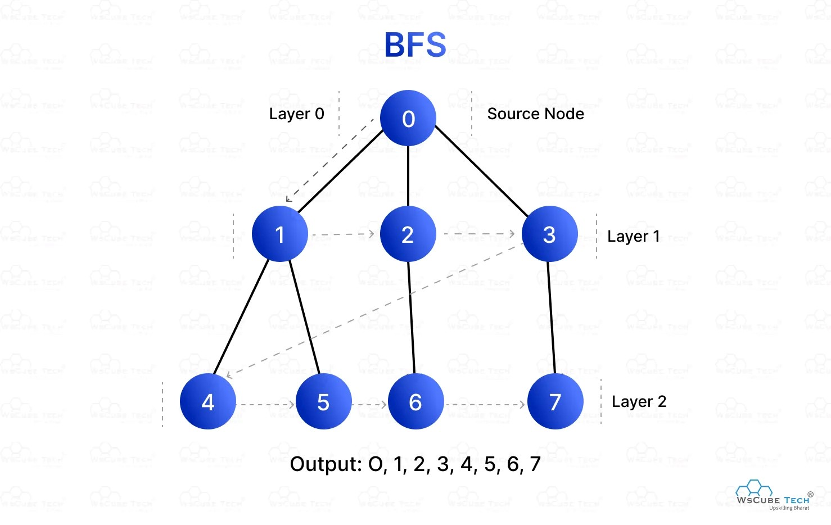
Breadth-First Search (BFS) Implementation

Slide 7
Breadth-First Search (BFS) Implementation
Traversal Order:
Starting from node 0:
Layer 0: Visit node 0 (source node).
Layer 1: Visit nodes 1, 2, 3 (neighbors of node 0).
Layer 2: Visit nodes 4, 5, 6, 7 (neighbors of nodes 1, 2, 3).
Output: 0, 1, 2, 3, 4, 5, 6, 7.

Slide 8
Applications of BFS:
Applications of BFS:
• Finding the shortest path in an unweighted graph.
• Checking graph connectivity.
• Solving mazes and puzzles.

Slide 9
Simple BFS Problems And Solution
BFS is a level-order traversal where we visit all neighboring nodes before going deeper. It uses a queue (FIFO: First In, First Out).
A
/ \
B C
/ \ \
D E F
BFS Traversal (Starting from A)
Start at A → Visit A, add its neighbors (B, C) to the queue.
Dequeue B → Visit B, add its neighbors (D, E) to the queue.
Dequeue C → Visit C, add its neighbor (F) to the queue.
Dequeue D → Visit D (no more neighbors).
Dequeue E → Visit E (no more neighbors).
Dequeue F → Visit F (no more neighbors).

Slide 10
Simple BFS Problems And Solution
Final BFS Order:A→B→C→D→E→F
Queue Operations
Step | Queue (FIFO) | Processing Node
1 | [B, C] | A
2 | [C, D, E] | B
3 | [D, E, F] | C
4 | [E, F] | D
5 | [F] | E
6 | [] | F

Slide 11
2.2 Depth-First Search (DFS)
DFS explores as far as possible along each branch before backtracking. It uses a stack (LIFO) or recursion.
DFS Algorithm:
Start from a source node.
Recursively explore each unvisited neighbor.
Backtrack when no unvisited neighbors are left.
Approach: DFS explores as deep as possible along a branch before backtracking. It uses a stack (or recursion) to keep track of nodes and backtracks when it reaches a dead end.
How it works: Starting from the source node, DFS goes deeper into the graph, visiting one branch of the graph first before backtracking to explore others.

Slide 12
Application of Depth-First Search (DFS)
Applications of DFS:
Topological sorting.
Detecting cycles in graphs.
Finding strongly connected components

Slide 13
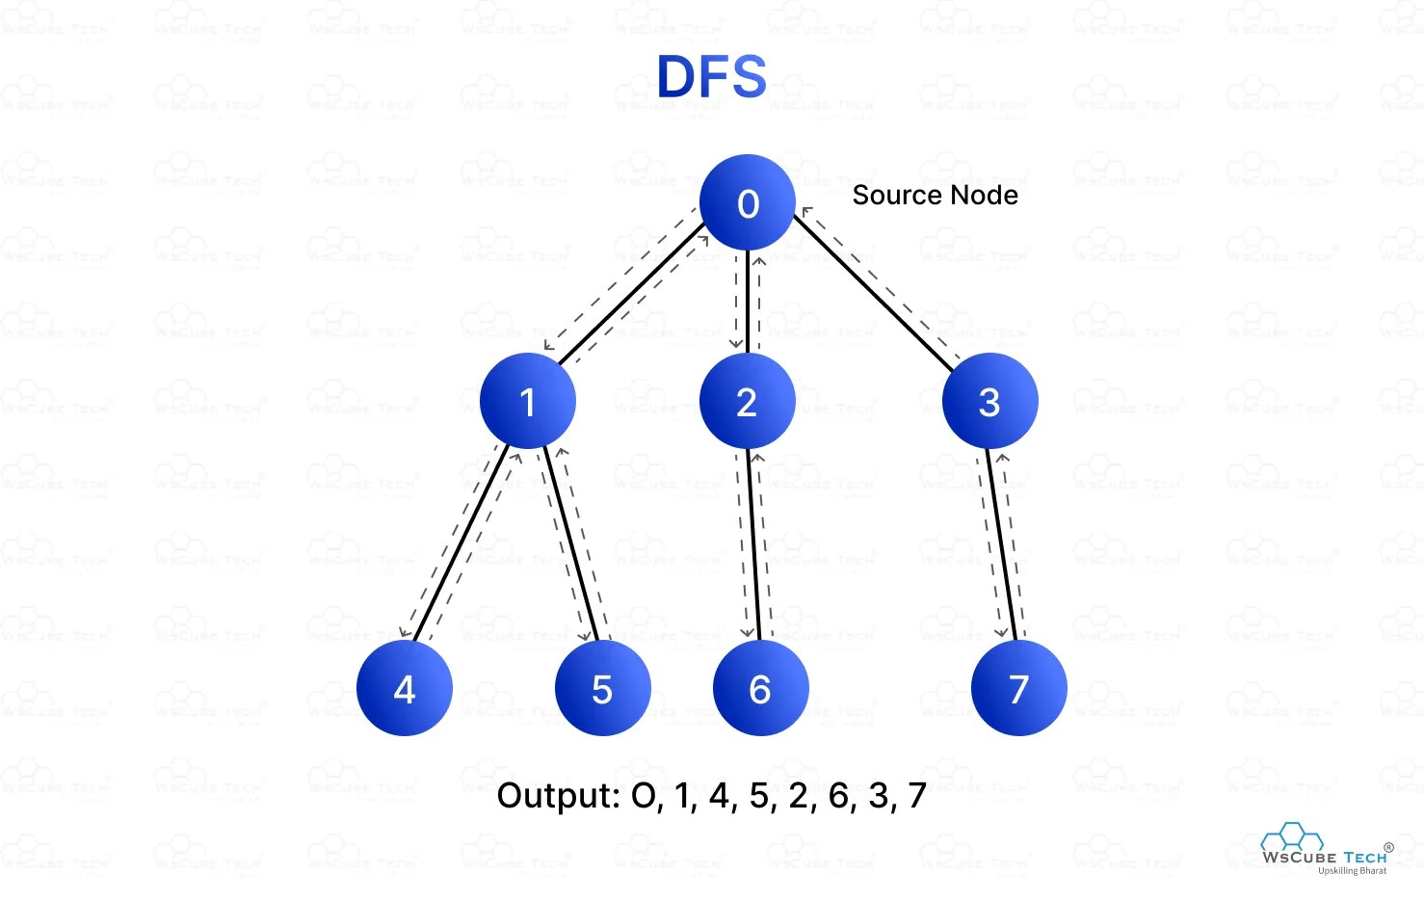
Depth-First Search (DFS)

Slide 14
Depth-First Search (DFS)
Traversal Order:
Starting from node 0:
Visit node 0 → Visit node 1 → Visit node 4 (deepest) → Backtrack to node 1 → Visit node 5 → Backtrack to node 0 → Visit node 2 → Visit node 6 → Backtrack to node 2 → Visit node 3 → Visit node 7.
Output: 0, 1, 4, 5, 2, 6, 3, 7

Slide 15
Simple Problems on DFS And Solution
Definition: DFS explores as deep as possible along a branch before backtracking. It uses a stack (LIFO: Last In, First Out).
A
/ \
B C
/ \ \
D E F
DFS Traversal (Starting from A)
Start at A → Visit A, push neighbors (B, C) to the stack.
Pop C → Visit C, push neighbor (F).
Pop F → Visit F (no more neighbors).
Pop B → Visit B, push neighbors (D, E).
Pop E → Visit E (no more neighbors).
Pop D → Visit D (no more neighbors).
Final DFS Order:
A→C→F→B→E→D

Slide 16
Simple Problems on DFS And Solution
Step-by-Step DFS Traversal (Using Stack)
Start at A
Visit A
Push its neighbors (B, C) onto the stack.
Stack: [B, C]
Pop C from stack (LIFO order)
Visit C
Push its neighbor F onto the stack.
Stack: [B, F]
Pop F from stack
Visit F

Slide 17
Simple Problems on DFS And Solution
F has no children, so nothing is pushed.
Stack: [B]
Pop B from stack
Visit B
Push its neighbors (D, E) onto the stack.
Stack: [D, E]
Pop E from stack
Visit E
E has no children, so nothing is pushed.
Stack: [D]
Pop D from stack
Visit D
D has no children, so nothing is pushed.
Stack: [] (Empty)
Final DFS Traversal Order
A → C → F → B → E → D ✅

Slide 18
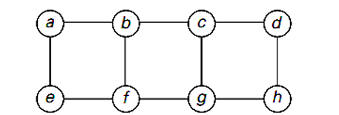
Problems on BFS And Solution
Consider the graph given in Fig
1.Starting at vertex ‘b’ and resolving ties by the vertex alphabetical
order, traverse the graph by Breadth First Search (BFS) and
construct the corresponding Breadth First Search Spanning Tree.
2.Illustrate the Queue operations for performing BFS Traversal to
obtain BFS Spanning Tree.
3.Specify all possible BFS Traversal sequences.

Slide 19
Simple Problems on DFS And Solution
BFS Traversal (Starting from 'b')
Start at 'b', enqueue → Queue: [b]
Visit neighbors: a, c, f (in alphabetical order) → Queue: [a, c, f]
Dequeue 'a', visit neighbors: e (already visited b) → Queue: [c, f, e]
Dequeue 'c', visit neighbors: d, g → Queue: [f, e, d, g]
Dequeue 'f', no new neighbors → Queue: [e, d, g]
Dequeue 'e', no new neighbors → Queue: [d, g]
Dequeue 'd', visit neighbor: h → Queue: [g, h]
Dequeue 'g', no new neighbors → Queue: [h]
Dequeue 'h', no new neighbors → Queue: [] (empty)
Final BFS Traversal Order:
✅ b → a → c → f → e → d → g → h

Slide 20
Problems on BFS And Solution
Step 2: BFS Spanning Tree
The BFS Spanning Tree includes edges that represent the first discovery of each node.
Root: b
Tree edges:
𝑏 → 𝑎
𝑏 →𝑐
𝑏 →𝑒
𝑏→𝑓
c→d
𝑒 →ℎ
𝑐→𝑔

Slide 21
The spanning tree structure:
b
/|\ \
a c e f
| | |
d g h

Slide 22
Possible BFS Traversal Sequences
Step 4: Possible BFS Traversal Sequences
Since BFS depends on tie-breaking when selecting neighbors, other BFS sequences can occur depending on how ties are resolved. The given order follows alphabetical order, but alternative tie-breaking might yield sequences such as:
b, a, c, e, f, g, d, h
b, a, c, f, e, d, g, h
b, c, a, e, f, d, g, h
Each sequence depends on which neighbor is processed first when multiple choices are available.

Slide 23
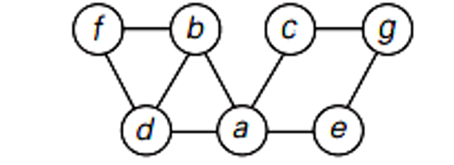
Problems on DFS and Solution
Consider the graph given in Fig.
1.Starting at vertex ‘a’ and resolving ties by the vertex alphabetical order, traverse the graph by Depth First Search and construct the corresponding Depth First Search Spanning Tree. 2.Show the traces of the traversal stack for DFS and specify the order in which vertices were pushed onto and popped off the stack.
3. Identify back edges, if any. “All DFS forests will have same number of tree edges and back edges”, Is this statement true? Justify the answer

Slide 24
Problems on DFS and Solution
Adjacency List Representation
From the image, we extract the edges:
a - b, a - c, a - d, a - e
b - f, b - d
c - g
So the adjacency list is:
a → {b, c, d, e}
b → {a, d, f}
c → {a, g}
d → {a, b}
e → {a}
f → {b}
g → {c}

Slide 25
Contd..
Final DFS Traversal Order:
a → b → d → f → c → g → e
Start at a.
Visit b (first available neighbor in alphabetical order).
From b, visit f (only neighbor).
Backtrack to b, no more unvisited neighbors.
Backtrack to a.
Visit c (next available neighbor).
From c, visit g (only neighbor).
Backtrack to c, no more unvisited neighbors.
Backtrack to a.
Visit d (next available neighbor).
Backtrack to a, no more unvisited neighbors.
Visit e (next available neighbor).
Backtrack to a, DFS complete.

Slide 26
DFS Spanning Tree: ..
Final DFS Traversal Order:
a → b → d → f → c → g → e
a
/ | | \
b c d e
/ |
f g
Tree Edges: These are the edges that form the DFS tree structure:
(a, b), (b, f), (a, c), (c, g), (a, d), (a, e)

Slide 27
DFS Stack Tracing
Final DFS Traversal Order:
a → b → d → f → c → g → e
Step | Action | Stack | Notes
1 | Push a | [a] | Start DFS
2 | Push b | [a, b] | Visit 'b'
3 | Push f | [a, b, f] | Visit 'f'
4 | Pop f | [a, b] | No more neighbors
5 | Pop b | [a] | No more neighbors
6 | Push c | [a, c] | Visit 'c'
7 | Push g | [a, c, g] | Visit 'g'
8 | Pop g | [a, c] | No more neighbors
9 | Pop c | [a] | No more neighbors
10 | Push d | [a, d] | Visit 'd'
11 | Pop d | [a] | No more neighbors
12 | Push e | [a, e] | Visit 'e'
13 | Pop e | [a] | No more neighbors
14 | Pop a | [] | DFS Complete

Slide 28
Contd..
Final DFS Traversal Order:
a → b → d → f → c → g → e
Step 4: Identify Back Edges
Back edges occur when a node links back to an already visited ancestor (except the direct parent).
No back edges exist in this DFS traversal.
The given graph is a tree (acyclic), so there are no cycles that would introduce back edges.
Are all DFS forests the same?
The statement "All DFS forests will have the same number of tree edges and back edges" is true because:
The number of tree edges (edges used in the DFS spanning tree) is always n-1 in a connected graph.
Back edges depend on cycles and remain consistent in all DFS forests.
Thus, while traversal order may change due to different starting points or tie-breaking, the total count of tree edges and back edges remains unchanged.

Slide 29
Criteria | BFS (Breadth-First Search) | DFS (Depth-First Search)
Traversal Method | Explores all neighbors at the current level before moving to the next level. | Explores as deep as possible along one branch before backtracking.
Data Structure Used | Queue (FIFO) | Stack (LIFO) or recursion stack.
Time Complexity | O(V + E) (V = vertices, E = edges) | O(V + E) (V = vertices, E = edges)
Space Complexity | O(V) (due to queue storing nodes at the current level) | O(V) (due to recursion or explicit stack)
Best for | Finding the shortest path in an unweighted graph. | Exploring all possible paths or solving puzzles like mazes.
Use Case | - Shortest path in unweighted graphs (like social networks, web crawlers). - Level-order traversal of trees. | - Solving maze or puzzle problems. - Detecting cycles in graphs, topological sorting.
Performance on Deep Graphs | May require more memory for wide/deep graphs, as the queue holds many nodes. | Efficient for deep graphs, as it traverses a single path at a time.
Performance on Wide Graphs | Efficient for shallow/wide graphs, as it processes level by level. | May require more memory for wide graphs, as the recursion stack can grow large.
Shortest Path | Guaranteed to find the shortest path in an unweighted graph. | Not guaranteed to find the shortest path, but explores all paths.
Pathfinding in Weighted Graphs | Not suitable for weighted graphs. | Not suitable for weighted graphs (Dijkstra's or Bellman-Ford should be used).
Cycle Detection | Can detect cycles, but less commonly used for it. | Useful for detecting cycles in directed or undirected graphs.
Recursive/Iterative | Iterative (uses a queue) | Can be recursive (via recursion stack) or iterative (using an explicit stack).
Graph Representation | Can be used with both adjacency lists and matrices. | Can be used with both adjacency lists and matrices.
Tree Traversal | Used for level-order traversal in trees. | Used for pre-order, in-order, and post-order traversal in trees.
Backtracking | No backtracking. | Uses backtracking to explore new branches.
Algorithm Type | Greedy approach (explores level by level). | Backtracking approach (explores depth first).

Slide 30
DFS vs BFS: Which is Faster?
DFS vs BFS: Which is Faster?
Neither DFS nor BFS is inherently faster than the other; both have the same time complexity of O(V + E), where V is the number of vertices and E is the number of edges.
However, BFS is faster for finding the shortest path in unweighted graphs, while DFS can be faster when searching deeper paths without concern for the shortest path. The speed depends on the specific problem and the structure of the graph.

Slide 31
When to Use: DFS vs BFS?
Application of DFS and BFS :
DFS Applications | BFS Applications
Cycle detection in graphs | Finding the shortest path in unweighted graphs
Finding connected components in a graph | Level-order traversal in trees
Solving puzzles like Sudoku, N-Queens (backtracking) | Web crawling (breadth-first)
Topological sorting in Directed Acyclic Graphs (DAGs) | Social network analysis (finding the shortest path between users)
Finding strongly connected components (Tarjan's/Kosaraju's algorithm) | Finding nodes at a specific level in a graph or tree
Maze solving (exploring all paths) | Minimum moves in a game or puzzle (e.g., 8-puzzle)
Web crawling (depth-first) | Friend suggestion algorithms in social networks
Tree traversal (pre-order, in-order, post-order) | Finding the shortest path in a maze
Pathfinding in games (exploring all paths) | Level-by-level exploration in AI game design

Slide 32
3. Implementing Graph Traversal Using Queues and Stacks
3. Implementing Graph Traversal Using Queues and Stacks
BFS uses a queue (FIFO) to explore nodes level by level.
DFS uses a stack (LIFO) or recursion to explore as far as possible before backtracking
BFS vs DFS Comparison:
Feature | BFS (Queue) | DFS (Stack/Recursion)
Data Structure | Queue (FIFO) | Stack (LIFO)
Traversal Order | Level-wise | Depth-wise
Uses | Shortest path, network broadcasting | Cycle detection, backtracking
Time Complexity | O(V + E) | O(V + E)

Slide 33
4. Directed Acyclic Graphs (DAG) and Topological Sorting
A Directed Acyclic Graph (DAG) is a directed graph with no cycles.
Topological Sorting
• A linear ordering of vertices such that for every directed edge (u → v), u appears before v.
• Used in task scheduling, dependency resolution, and course prerequisites.
Topological Sorting Algorithm (Using DFS):
def topological_sort(graph, node, visited, stack):
visited.add(node)
for neighbor in graph[node]:
if neighbor not in visited:
topological_sort(graph, neighbor, visited, stack)
stack.append(node)
Applications of Topological Sorting:
• Task scheduling (e.g., job scheduling in an operating system)
• Course prerequisite management
• Dependency resolution (e.g., package installation order)

Slide 34
5.Merge Sort Algorithm (Divide and Conquer)
Merge Sort Algorithm (Divide and Conquer):
Merge Sort is a divide and conquer algorithm that:
Divides the array into halves.
Recursively sorts both halves.
Merges the sorted halves.

Slide 35
5.Merge Sort Algorithm (Divide and Conquer)
Merge Sort Algorithm Steps
Divide: Split the array into two halves.
Conquer: Recursively sort both halves.
Merge: Combine the sorted halves back into a single sorted array.

Slide 36
5.Merge Sort Algorithm (Divide and Conquer)
MergeSort(A, left, right)
1. If left < right:
2. Find the middle index: mid = (left + right) / 2
3. Recursively call MergeSort on first half: MergeSort(A, left, mid)
4. Recursively call MergeSort on second half: MergeSort(A, mid + 1, right)
5. Merge the two sorted halves: Merge(A, left, mid, right)

Slide 37
5.Merge Sort Algorithm (Divide and Conquer)
Merge(A, left, mid, right)
1. Create two temporary arrays:
LeftArray = A[left...mid]
RightArray = A[mid+1...right]
2. Set i = 0 (index for LeftArray)
3. Set j = 0 (index for RightArray)
4. Set k = left (index for merged array)
5. While i < size of LeftArray AND j < size of RightArray:
If LeftArray[i] ≤ RightArray[j]:
A[k] = LeftArray[i]
i = i + 1
Else:
A[k] = RightArray[j]
j = j + 1
k = k + 1
6. Copy remaining elements of LeftArray (if any) into A
7. Copy remaining elements of RightArray (if any) into A

Slide 38
5.Merge Sort Algorithm (Divide and Conquer)
Step 1: Divide
[38, 27, 43, 3] | [9, 82, 10]
Step 2: Further Divide
[38, 27] | [43, 3] | [9, 82] | [10]
Step 3: Base Case Reached (Single Elements)
[38] | [27] | [43] | [3] | [9] | [82] | [10]
Step 4: Merge Pairs
[27, 38] | [3, 43] | [9, 82] | [10]
Step 5: Merge Again
[3, 27, 38, 43] | [9, 10, 82]
Step 6: Final Merge
[3, 9, 10, 27, 38, 43, 82] (Sorted Array)

Slide 39
5.Merge Sort Algorithm (Divide and Conquer)
Merge Sort Complexity:
• Time Complexity: O(n log n)
• Space Complexity: O(n)
Applications of Merge Sort:
• Sorting linked lists (since it doesn’t require random access like QuickSort).
• External sorting (e.g., sorting huge datasets that don’t fit into RAM).
• Stable sorting (preserving the order of equal elements).

Slide 40
5.Quick Sort
Steps of Quick Sort:
Pick a pivot (typically the last or first element).
Partition the array:
Move smaller elements to the left of the pivot.
Move larger elements to the right of the pivot.
Recursively apply Quick Sort on the left and right partitions.

Slide 41
5.Advantages of Quick Sort
Advantages of Quick Sort
It is a divide-and-conquer algorithm that makes it easier to solve problems.
It is efficient on large data sets.
It has a low overhead, as it only requires a small amount of memory to function.
It is Cache Friendly as we work on the same array to sort and do not copy data to any auxiliary array.
Fastest general purpose algorithm for large data when stability is not required.

Slide 42
5.Disadvantages of Quick Sort
Disadvantages of Quick Sort
It has a worst-case time complexity of O(n²), which occurs when the pivot is chosen poorly.
It is not a good choice for small data sets.
It is not a stable sort, meaning that if two elements have the same key, their relative order will not be preserved in the sorted output in case of quick sort, because here we are swapping elements according to the pivot’s position (without considering their original positions).

Slide 43
5. Application of Quick Sort
Applications of Quick Sort
Efficient for sorting large datasets with O(n log n) average-case time complexity.
Used in partitioning problems like finding the kth smallest element or dividing arrays by pivot.
Integral to randomized algorithms, offering better performance than deterministic approaches.
Applied in cryptography for generating random permutations and unpredictable encryption keys.
Partitioning step can be parallelized for improved performance in multi-core or distributed systems.
Important in theoretical computer science for analyzing average-case complexity and developing new techniques.

Slide 44
5. Picking Pivot Element
Always pick the first (or last) element as a pivot. The below implementation picks the last element as pivot. The problem with this approach is it ends up in the worst case when array is already sorted.
Pick a random element as a pivot. This is a preferred approach because it does not have a pattern for which the worst case happens.
Pick the median element is pivot. This is an ideal approach in terms of time complexity as we can find median in linear time and the partition function will always divide the input array into two halves. But it takes more time on average as median finding has high constants.

Slide 45
5. Quick Sort Example
Example: Sorting [10, 5, 2, 8, 7, 3]
Step 1: Choose Pivot
We pick the last element as the pivot: 3
Step 2: Partition the Array
• Left Partition (≤ 3): [2]
• Pivot: [3]
• Right Partition (> 3): [10, 5, 8, 7]
Now, recursively sort the left and right partitions.
________________________________________
Step 3: Sort Left Partition [2]
Since it has only one element, it remains [2].

Slide 46
5. Quick Sort Example
Step 4: Sort Right Partition [10, 5, 8, 7]
• Pivot = 7
• Left Partition (≤ 7): [5]
• Pivot: [7]
• Right Partition (> 7): [10, 8]
Now, sort [5] (already sorted) and [10, 8].
________________________________________
Step 5: Sort Right Partition [10, 8]
• Pivot = 8
• Left Partition (≤ 8): [] (empty)
• Pivot: [8]
• Right Partition (> 8): [10]
Sorted result: [8, 10]
________________________________________
Step 6: Merge Results
• [2] + [3] + [5] + [7] + [8, 10]
• Final sorted array: [2, 3, 5, 7, 8, 10]

Slide 47
Topological Sorting
Topological sorting is a linear ordering of vertices in a Directed Acyclic Graph (DAG) such that for every directed edge (U → V), the vertex U appears before V in the ordering.
In simple terms:
It arranges nodes sequentially while ensuring that dependencies (edges) are respected.
It is only possible in DAGs (graphs without cycles).
Steps to be followed for Topological sorting
DFS Exploration Order: Explain that DFS visits deeper nodes first.
Stack Push Order: Show that nodes are pushed to the stack only after all their dependencies are resolved.
Reversing the Stack: Emphasize that the correct topological order is obtained by popping elements from the stack.

Slide 48
Topological Sorting Example
• A → C → E
↓ ↓
B D → F
Step 1: Compute In-Degrees
Each node's in-degree (number of incoming edges):
Node In-Degree
A 0
B 1 (from A)
C 1(from A)
D 1 (from C)
E 1 (from C)
F 1 (from D)

Slide 49
Topological Sorting Example
Start from A (no incoming edges).
Explore B, then push it to the stack.
Explore C, then go to D → F, pushing F and D in order.
Explore E, then push E to the stack.
Push C, then push A at the end.
Final stack (bottom to top): A → B → C → E → D → F

Slide 50
Topological Sorting Example
•
Step 3: Stack at the End (Bottom to Top)
A → B → C → E → D → F
________________________________________
Step 4: Obtain the Final Topological Order
After popping the stack, the correct Topological Order is:
A→B→C→E→D→F
________________________________________
✅ Final Answer (DFS-Based Topological Sorting):
A→B→C→E→D→F

Slide 51
Topological Sorting Example
• 10 → 5 → 3
↓ ↓
6 7 → 8
Step 1: Identify In-Degrees
Each node's in-degree (number of incoming edges):
10 → 0 (no incoming edges)
5 → 1 (from 10)
3 → 1 (from 5)
6 → 1 (from 10)
7 → 1 (from 5)
8 → 1 (from 7)

Slide 52
Topological Sorting Example
• Start DFS from 10
Visit 5 → Visit 3 → Push 3 to stack
Visit 7 → Visit 8 → Push 8 to stack
Push 7, then 5 to stack
Visit 6 from 10 → Push 6 to stack
Push 10 to stack (as all dependencies are processed)

Slide 53
Topological Sorting Example
• Step 3: Obtain the Topological Order
Final Stack (top to bottom):
10 → 6 → 5 → 7 → 8 → 3
Final Topological Sorting (Popping Stack):
10→6→5→7→8→3

Slide 54
Topological Sorting Example
• Why Do We Reverse the Stack?
The first element pushed into the stack is the last to be completed in DFS.
The last element pushed is the first one that should appear in topological order.
Reversing the stack ensures that dependencies appear before dependents.
Thus, when we print the stack in reverse order, we get the correct topological sort order.

Slide 55
Master Theorm
• The Master Theorem is a powerful tool used to solve recurrence relations that arise in the analysis of divide-and-conquer algorithms. It provides a systematic way to determine the time complexity of recursive algorithms of the form:
We use the Master Theorem to quickly find the time complexity of divide-and-conquer problems. It applies to recurrence relations of this type:
T(n)=aT(n/b) +f(n)
where n = Input size
a = Number of subproblems
b = How much each subproblem reduces (factor)
f(n) = Work done outside recursion (splitting/merging)

Slide 56
Master Theorm
Three Simple Cases
If grows slower → Answer = O(n^{\log_b a})
If grows at the same speed → Answer = O(n^{\log_b a} \log n)
If grows faster → Answer = O(f(n))

Slide 57
Master Theorm
Examples (Step-by-Step)
Example 1:
T(n) = 4T(n/2) + n
a = 4, b = 2, f(n) = n
Compute log_2 4 = 2 (since 2² = 4)
Compare f(n) = n with n²
n is smaller than n²
Use Case 1 → Answer: O(n²)

Slide 58
Master Theorm
Example 2:
T(n) = 2T(n/3) + n
a = 2, b = 3, f(n) = n
Compute log_3 2 ≈ 0.63
Compare f(n) = n with n^0.63
n is bigger than n^0.63
Use Case 3 → Answer: O(n)

Slide 59
Master Theorm
The recurrence relation for Merge Sort is: T(n) = 2T(n/2) + O(n)
where:
a = 2 → The problem is divided into two subproblems.
b = 2 → Each subproblem is of size n/2.
f(n) = O(n) → The merging step takes linear time.

Slide 60
Master Theorm
Step 1: Compute log_b a
log₂ 2 = 1
Step 2: Compare f(n) with n^(log_b a)
f(n) = O(n) n^(log₂ 2) = n¹ = O(n)
Since f(n) is equal to O(n^(log_b a)),
we apply Case 2 of the Master Theorem, which gives: T(n) = O(n log n)
Final Answer:
Merge Sort runs in O(n log n) time complexity

Slide 61


